Slide 1
Ophthalmic Optics
Review 2019
Chris Woodruff

Slide 2
Ophthalmic Prism
Prism Effects in Periphery of Lens
Decentration
Major Reference Points
Correction of Vertical Prism Effect
Thickness Difference Across a Prism

Slide 3
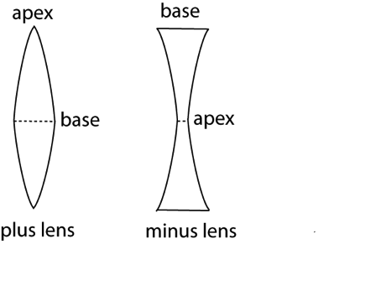
Ophthalmic Prism / Prism Effects
Prism Effects in the Periphery of a Lens

Slide 4
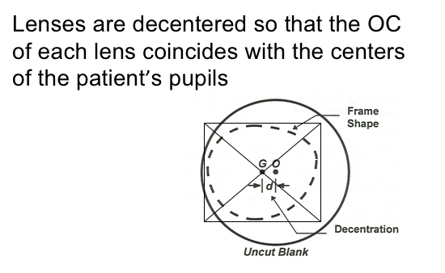
Ophthalmic Prism / Prism Effects
Decentration

Slide 5
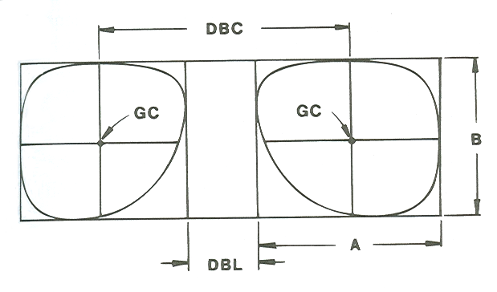
Optical Characteristics of Lenses
Major Reference Points
Optical Center & Geometrical Center
OC
OC
Patient PD

Slide 6
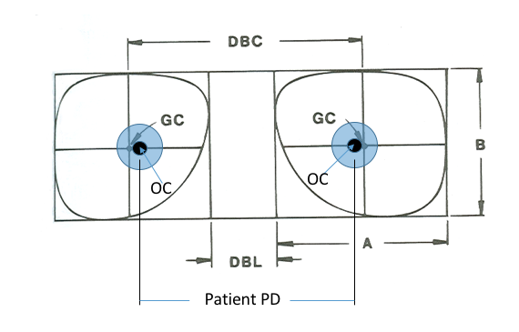
Ophthalmic Prism / Prism Effects
dec = (frame PD – Patient PD) / 2
Decentration
Decentration (dec)

Slide 7
Ophthalmic Prism
What happens when PD in Rx doesn’t match Patient PD?
Minus Rx
PD larger than Patient PD: BI prism from each lens*
Creates demand for Divergence (NFV)
PD smaller than Patient PD: BO prism from each lens
Creates demand for Convergence (PFV)
Plus Rx
PD larger than Patient PD: BO prism from each lens*
Creates demand for Convergence (PFV)
PD smaller then Patient PD: BI prism from each lens
Creates demand for Divergence (NFV)
*occurs when reading with distance Rx

Slide 8
Ophthalmic Prism
What happens to Phoria when PD is not correct?
Minus Rx
PD larger than Patient PD: BI prism from each lens*
Phoria appears more ESO than actual
PD smaller than Patient PD: BO prism from each lens
Phoria appears more EXO than actual
Plus Rx
PD larger than Patient PD: BO prism from each lens*
Phoria appears more EXO than actual
PD smaller then Patient PD: BI prism from each lens
Phoria appears more ESO than actual
*occurs when reading with distance Rx

Slide 9
Ophthalmic Prism
Who benefits from induced prism at near?
Minus Rx
PD larger than Patient PD: BI prism from each lens*
Benefits the EXO patient
Plus Rx
PD larger than Patient PD: BO prism from each lens*
Benefits the ESO patient
*occurs when reading with distance Rx

Slide 10
Ophthalmic Prism / Prism Effects
Correction of Vertical Prism Effect
With Anisometropic Spectacle Rx:
Greatest concern for prismatic effects is for presbyopic patient looking down to use multifocal segment when reading.
Solutions include:
Slab Off Prism
Double Slab Off Prism
Dissimilar Segments
Compensated R Segments
Prism Segments
Multiple Corrections
Contact Lenses
Fresnel Prism
Fresnel Adds

Slide 11
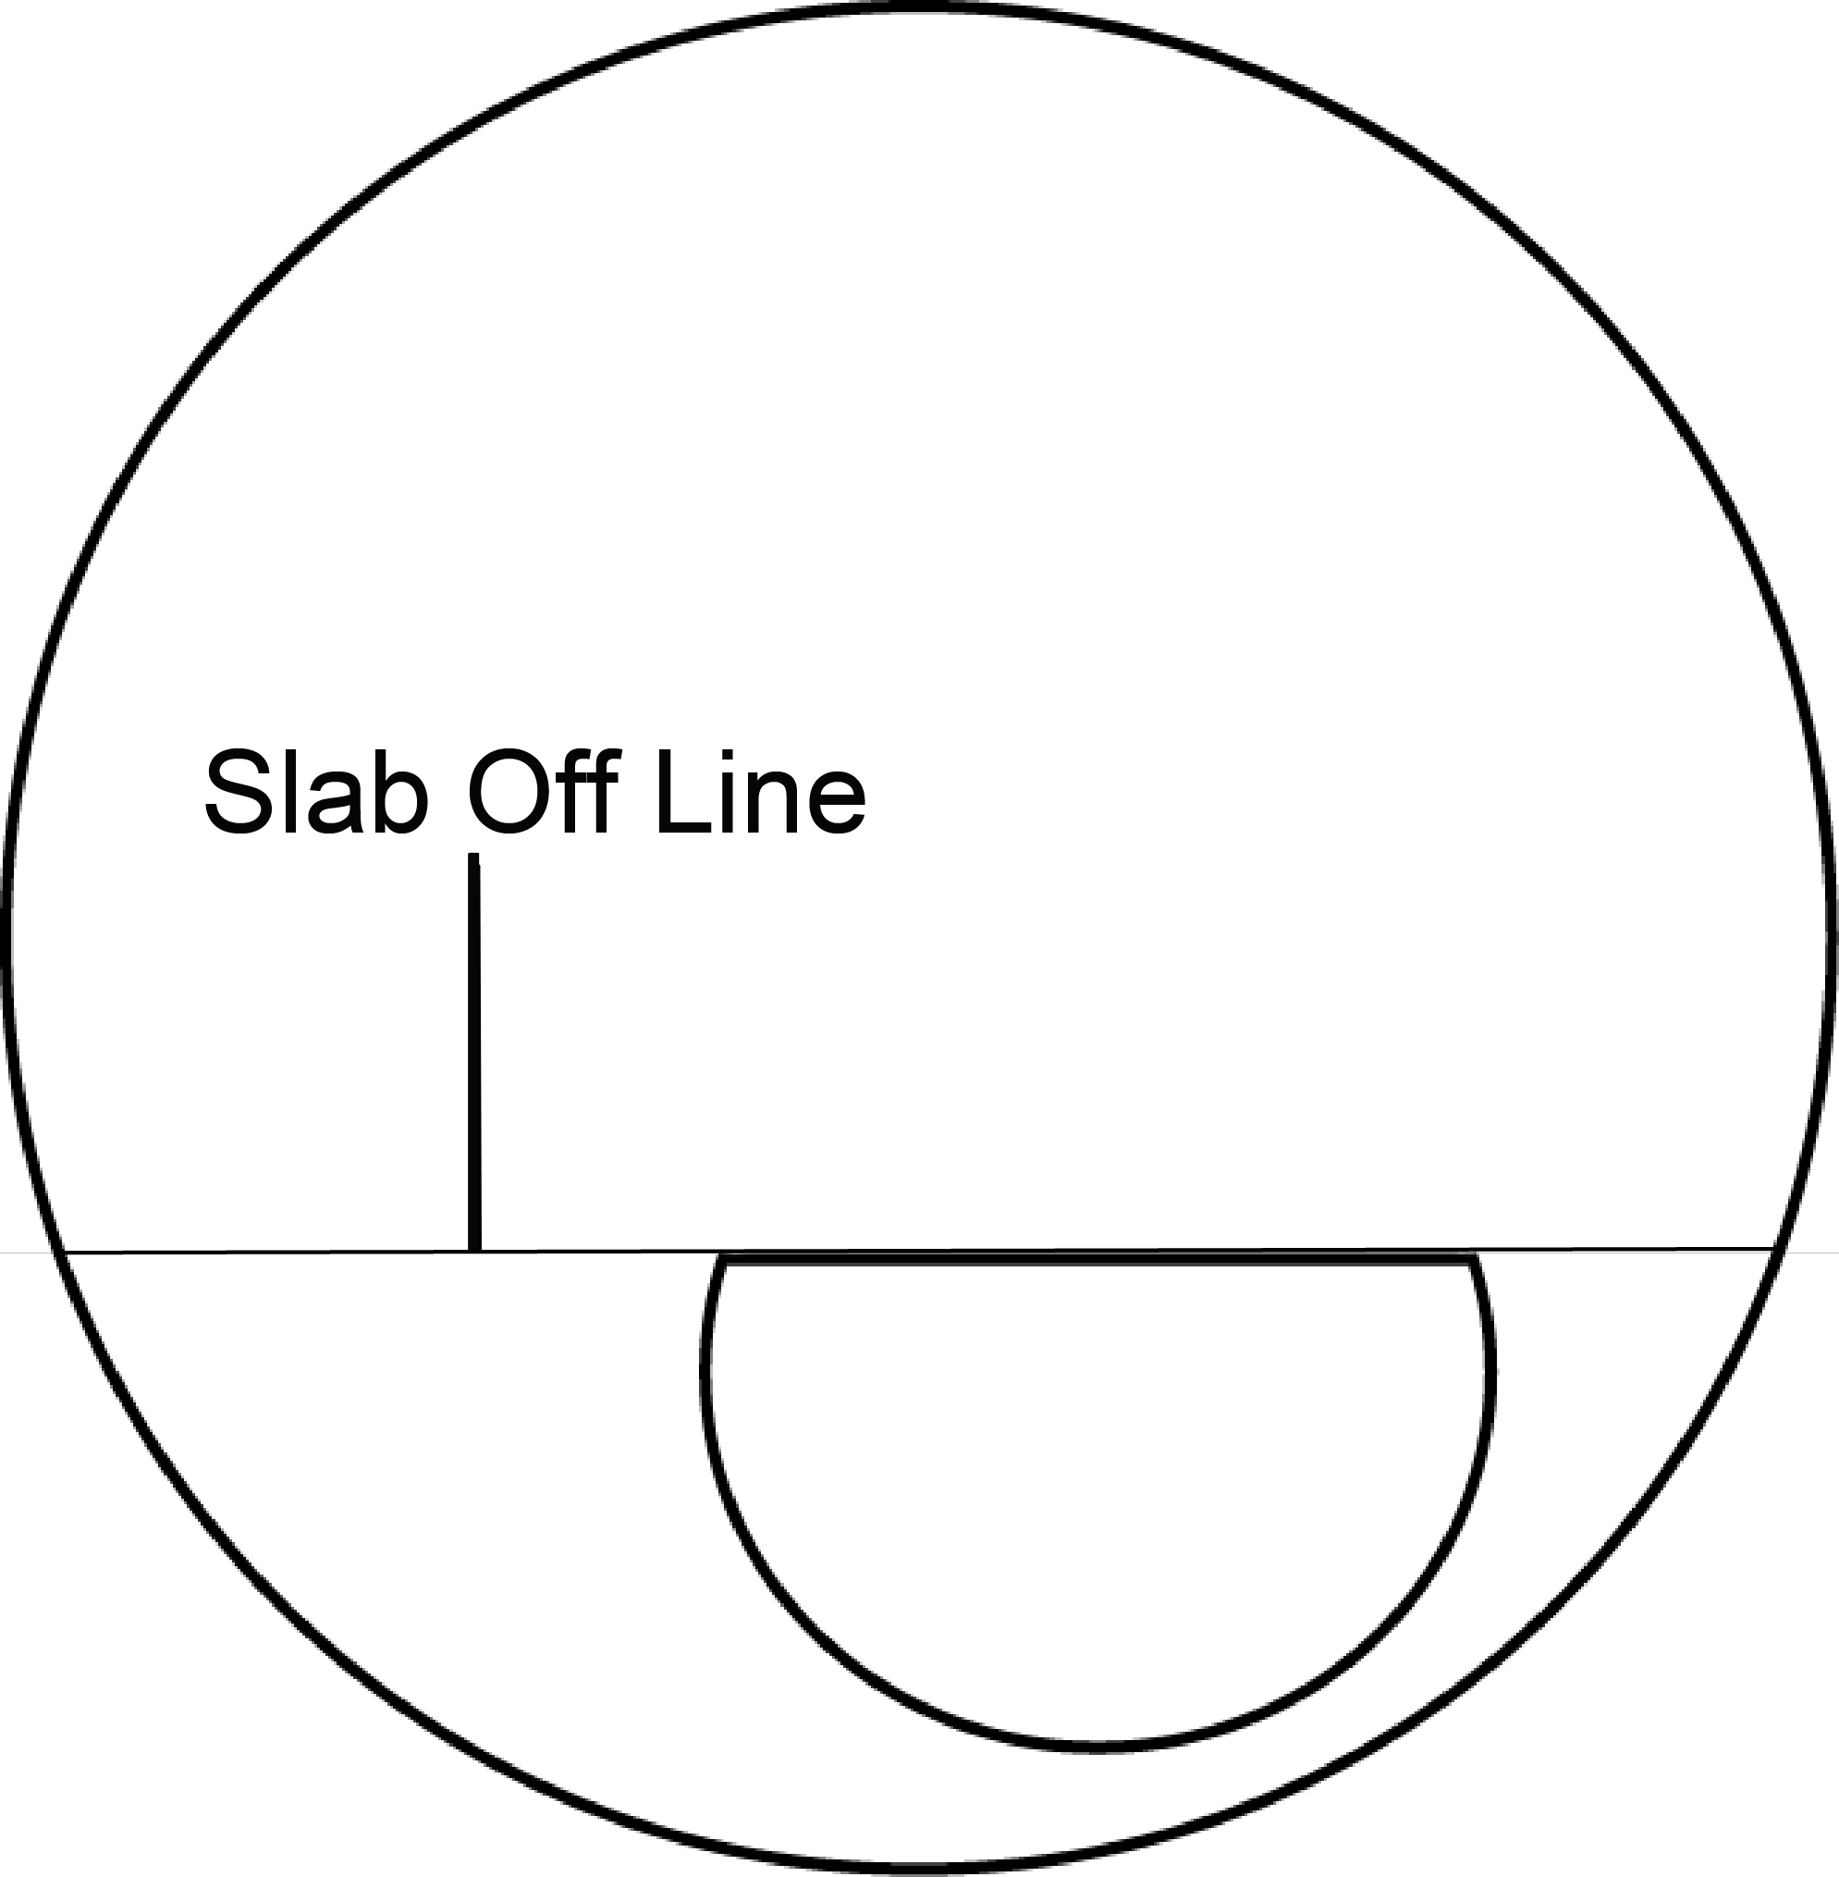
Ophthalmic Prism / Prism Effects
Correction of Vertical Prism Effect
Slab Off Prism
Bi-centric grinding
Plastic lens: applied to back surface
Glass lens: applied to front surface
Results in the removal of base down prism
Applied to lens with least plus or most minus power
Slab off line at segment top for segmented bifocal
Slab off line slightly above near verification circle on PAL

Slide 12
Ophthalmic Prism / Prism Effects
Correction of Vertical Prism Effect
Slab Off Prism
Reverse Slab Off Prism
Base down prism is cast into the near portion of the lens
Applied to lens with most plus or least minus power
Double Slab Off Prism
Done with high minus lenses
Remove base down from each lens
Reducing prism effect in downgaze and reducing imbalance

Slide 13
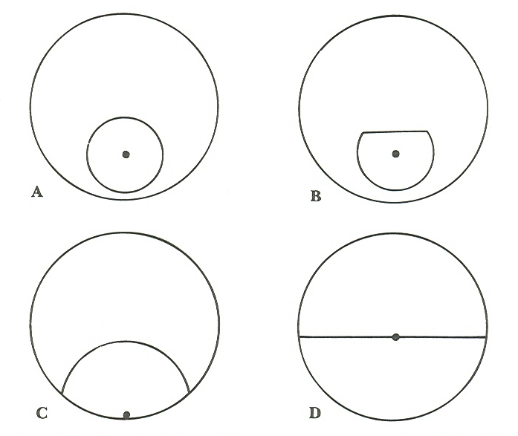
Ophthalmic Prism / Prism Effects
Correction of Vertical Prism Effect
Dissimilar Segments
Use two different types of multifocal segment
Create prism to neutralize prism in downgaze due to aniso Rx
Seg OC 5mm below segment top
Seg OC ½ segment diameter below segment top
Seg OC at segment top

Slide 14
Ophthalmic Prism / Prism Effects
Correction of Vertical Prism Effect
Compensated R Segments
R (ribbon) Segments are available with Segment OC in positions ranging from 4 to 10mm below segment top.
Maximum prism is limited
Ex: +2.00D can create (0.6 x 2.00) = 1.2 prism diopters

Slide 15
Ophthalmic Prism / Prism Effects
Correction of Vertical Prism Effect
Prism Segments
Prism provided by segment
Rarely Used
Expensive
Thick
Special Order
Limited Availability

Slide 16
Ophthalmic Prism / Prism Effects
Correction of Vertical Prism Effect
Multiple Corrections
Different Distance & Near Corrections
Eliminate need for downgaze with near Rx

Slide 17
Ophthalmic Prism / Prism Effects
Correction of Vertical Prism Effect
Contact Lenses
Contact Lenses usually fit to move with the eye in downgaze so prism not induced in downgaze
Can use multifocal CL, monovision, reading Rx over CLs

Slide 18
Ophthalmic Prism / Prism Effects
Correction of Vertical Prism Effect
Fresnel Prism / Fresnel Add
Used for temporary applications
Reduce contrast and Visual Acuity

Slide 19
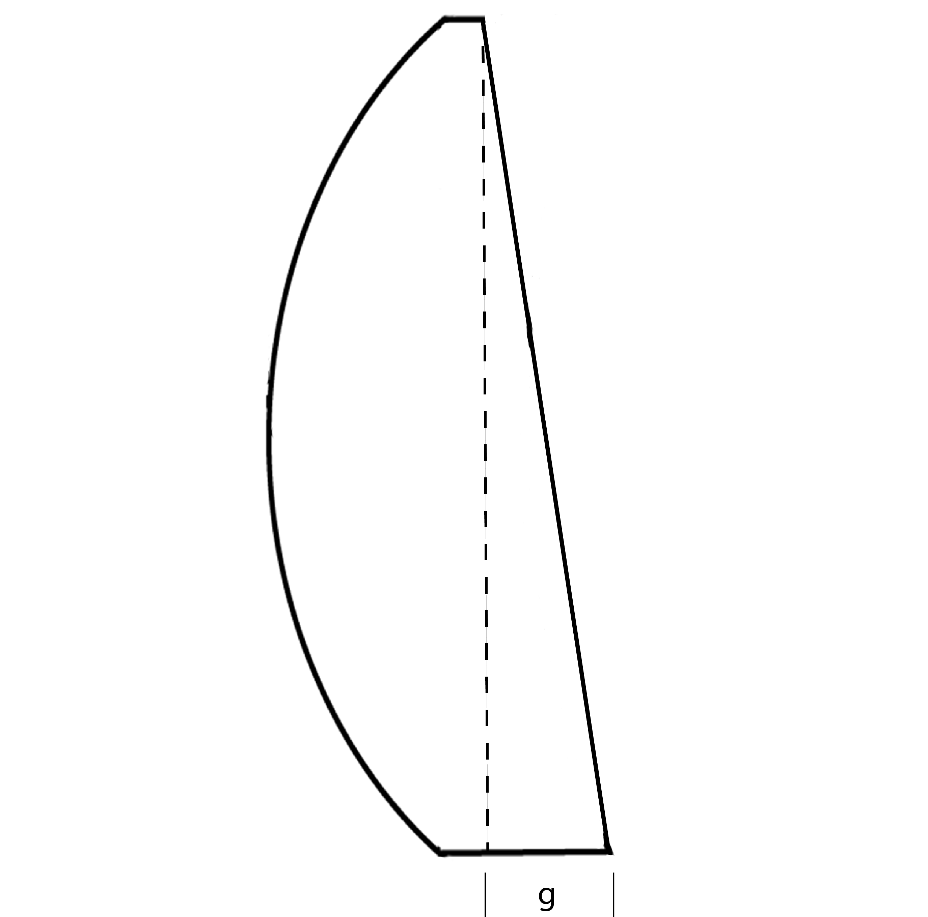
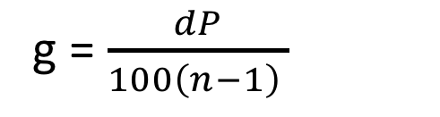
Ophthalmic Prism / Prism Effects
Thickness difference across a prism
Thickness attributed to prism:
g = $\frac{dP}{100\left(n−1\right) }$
Where:
d = lens diameter
P = prism power
n = index of refraction

Slide 20
Aberrations & Lens Design
Aberrations
Chromatic
Monochromatic
Principles of Corrected Curve Design

Slide 21
Aberrations
Chromatic Aberration
Characteristic of Lens Material
Monochromatic Aberrations
Characteristic of Lens Design
Spherical Aberration
Coma
Oblique Astigmatism*
Curvature of Field (Image)**
Distortion
*most important
**second most important

Slide 22
Aberrations
Monochromatic Aberrations
Spherical Aberration*
Coma*
Oblique Astigmatism*
Curvature of Field (Image)*
Distortion**
*defocus
**shape problem

Slide 23
Aberrations
Monochromatic Aberrations
These are usually ignored:
Spherical Aberration
Coma
Distortion
These are controlled through base curve selection:
Oblique Astigmatism
Curvature of Field (Image)

Slide 24
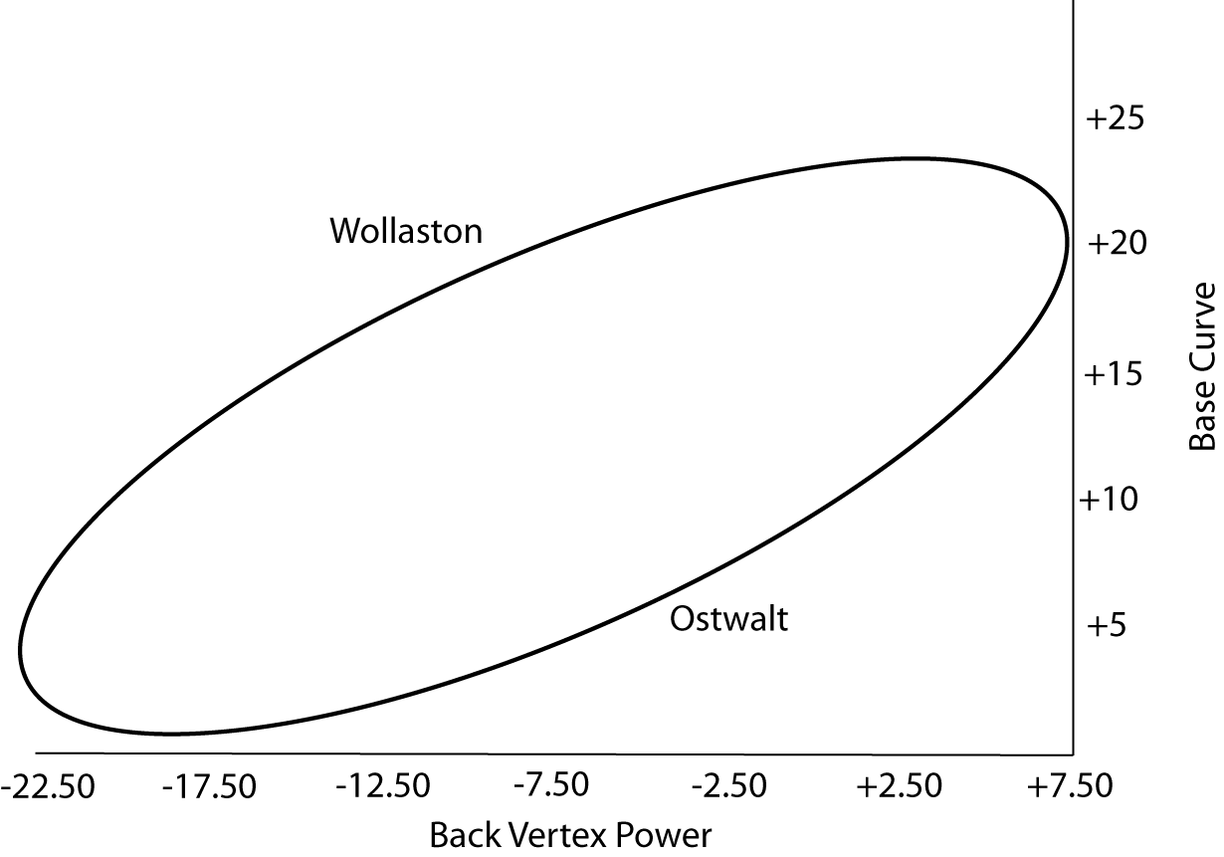
Optical Characteristics of Lenses
Principles of Corrected Curve Design
Corrected curve lenses are designed to minimize aberrations through proper base curve selection.
Based on the work of Ostwalt
Each lens material has a different curve

Slide 25
Optical Characteristics of Lenses
Principles of Corrected Curve Design
Base curves are selected to minimize Oblique Astigmatism (and also reduce Curvature of Field):

Slide 26
Anisometropia & Aniseikonia
Concerns with Anisometropia
Spectacle Magnification
Eikonic Lens Design

Slide 27
Anisometropia
There are 3 Major Concerns for Anisometropia
Children developing Amblyopia
Induced Prism in Lateral / Vertical Gaze
Aniseikonia

Slide 28
Anisometropia
Children Developing Amblyopia
Occurs when one eye is rarely / never used
Examples:
OD: +4.00
OS: Plano
OD requires more accommodation at both distance and near
OD: +2.00
OS: +4.00
OS requires more accommodation at both distance and near

Slide 29
Anisometropia
Induced Prism in Lateral / Vertical Gaze
Lateral Prism:
Not a problem in small or moderate amounts
Vertical Prism:
Can be a problem with as little as 1.00D of anisometropia
For typical reading position this creates 1 prism diopter
imbalance
Vertical Prism most problematic with presbyopia (trying to look down through bifocal segment)

Slide 30
Anisometropia
Aniseikonia
Unequal Size and / or Shape of retinal image

Slide 31
Optical Characteristics of Lenses
Spectacle Magnification
Shape & Power Factors
Where:
t = lens thickness
n = index of lens
P₁ = front surface power
P_{V} = back vertex power
d = distance from lens to entrance pupil of eye (vertex distance + 3mm)
Shape
Factor
Power
Factor

Slide 32
Optical Characteristics of Lenses
Spectacle Magnification
Iseikonic Lens Design
Shape Factor
  Front Surface Power (P1)
  Lens thickness (t)
  Increasing P1 or t increases magnification (decreases minification)
Power Factor
  Back Vertex Power (Pv)
  Distance from lens to entrance pupil
  Increasing vertex distance increases magnification (plus lens) or minification (minus lens)

Slide 33
Optical Characteristics of Lenses
Spectacle Magnification
Iseikonic Lens Design
Parameters we can manipulate to change SM:
  Front Surface Power (P1)
  Lens thickness (t)
  Vertex Distance
For Most Plus Lens:
Decrease Magnification:
Decrease Base Curve (flatten)
Decrease Lens Thickness
Decrease Vertex Distance
For Most Minus Lens:
Increase Magnification:
Increase Base Curve (steeper)
Increase Lens Thickness
Increase Vertex Distance

Slide 34
Lens Materials & Standards
Characteristics of Lens Materials
Refractive Index
Dispersion
Specific Gravity
Impact Resistance

Slide 35
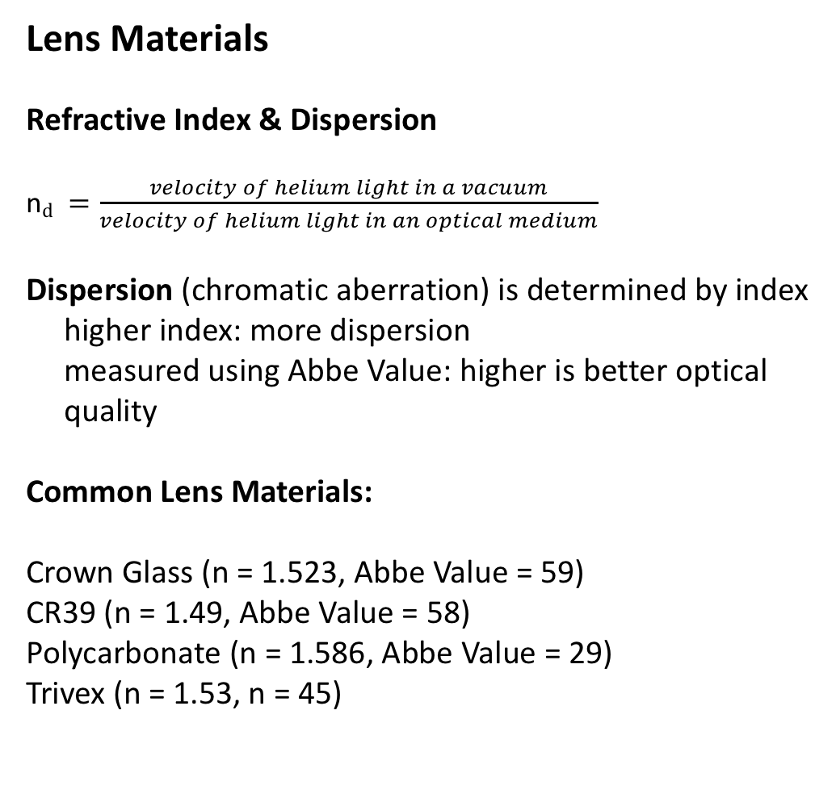
Physical Characteristics of Lenses
Lens Materials
Refractive Index & Dispersion
n$d =\frac{velocity of helium light in a vacuum}{velocity of helium light in an optical medium}$
Dispersion (chromatic aberration) is determined by index
higher index: more dispersion
measured using Abbe Value: higher is better optical
quality
Common Lens Materials:
Crown Glass (n = 1.523, Abbe Value = 59)
CR39 (n = 1.49, Abbe Value = 58)
Polycarbonate (n = 1.586, Abbe Value = 29)
Trivex (n = 1.53, n = 45)

Slide 36
Physical Characteristics of Lenses
Lens Materials
Specific Gravity
Specific Gravity gives an indication of the weight of a lens
higher Specific Gravity: heavier lens
Specific Gravity: ratio of lens material to water
Common Lens Materials:
Crown Glass (specific gravity: 2.54)
CR39 (specific gravity: 1.32)
Polycarbonate (specific gravity: 1.22)
Trivex (specific gravity: 1.11)

Slide 37
Impact Resistance
Impact Resistance varies between lens materials
Glass (must be tempered)
Thermal Tempering
Chemical Tempering
Increase impact resistance by increasing thickness
CR 39 Plastic
Increase impact resistance by increasing thickness
Polycarbonate / Trivex
More impact resistant than CR 39
Can use thinner lenses for dress eyewear
Use thicker lenses for safety applications

Slide 38
Impact Resistance
FDA requires ALL prescription spectacle lenses to be impact resistant enough to pass drop ball test
Higher impact resistance standard for safety eyewear then for dress eyewear
Dress eyewear: 5/8 inch steel ball (0.56oz) dropped 50 inches
Safety eyewear: 1 inch steel ball (2.4oz) dropped 50 inches

Slide 39
Impact Resistance
Impact Resistance varies between lens materials
Any coating applied to a lens will DECREASE its impact resistance
Coatings are harder than the lens material and therefore more likely to shatter and cause lens to break
Polycarbonate and Trivex are more impact resistant than Glass and CR 39 because they are softer materials
They absorb impact and become deformed, but not shattered

Slide 40
Properties of Ophthalmic Lenses
Physical Characteristics
Optical Characteristics

Slide 41
Physical Characteristics of Lenses
Geometry of Lens Surfaces
Spherical
Same radius of curvature at every point on the surface
Cylindrical
Two radii, one is infinite
Two surface powers, one is plano
Toric
Two radii, neither is infinite
Two surface powers, neither is plano
Aspheric
Literally: not spherical
Radius of curvature varies from center to periphery of lens

Slide 42
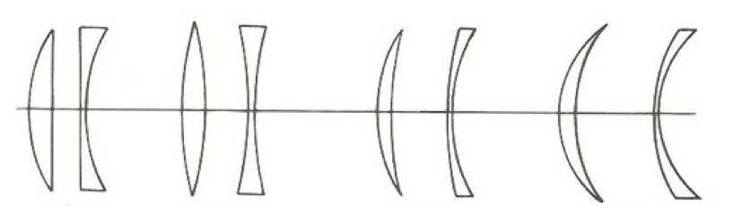
Physical Characteristics of Lenses
Base Curve (Lens Form)
Base Curve: the least plus power on front surface of spectacle lens
Lens Form: the relationship between front and back surfaces of spectacle lens

Slide 43
Physical Characteristics of Lenses
Lens Form
Plano / Convex
Plano / Concave
Biconvex
Biconcave
Meniscus
Front Toric (plus cylinder design)
Back Toric (minus cylinder design)
Bitoric

Slide 44
Physical Characteristics of Lenses
Lens Form: Modern Spectacle Lens Design
Meniscus Design
Plus Spherical Front Surface
Minus Spherical/Cylindrical Back Surface
Exceptions: Eikonic Lens Designs

Slide 45
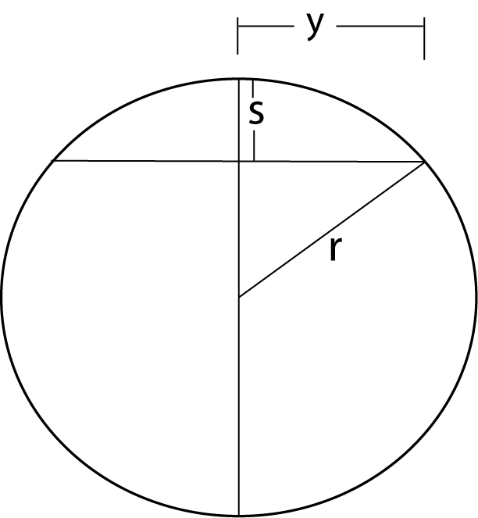
Physical Characteristics of Lenses
Lens Form Influences:
Optical Quality (aberrations)
Thickness (flatter lenses are thinner)
Cosmetic Appearance (reflections and thickness)
Approximate Sag Formula

Slide 46
Physical Characteristics of Lenses
Why do we care about sagittal depth?
1. Provides a way to estimate lens power (Lens Clock)
2. Influences lens thickness

Slide 47
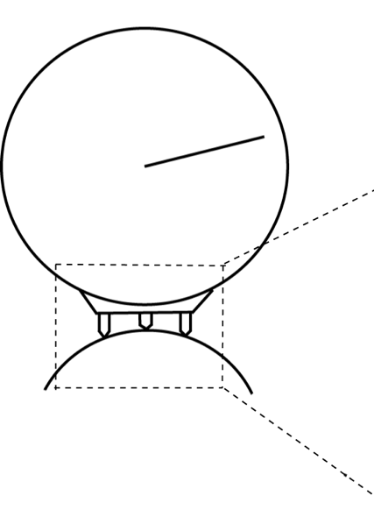
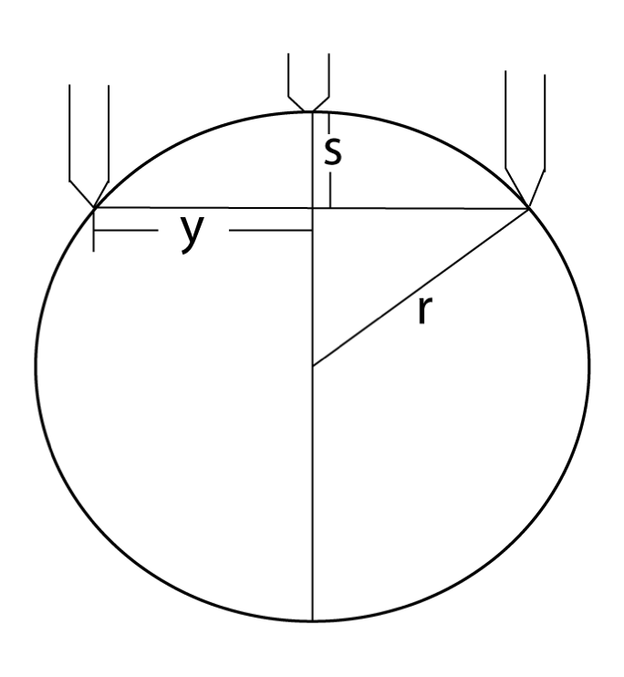
Physical Characteristics of Lenses
Lens Clock
Estimate surface power
Direct measurement of sagittal depth

Slide 48
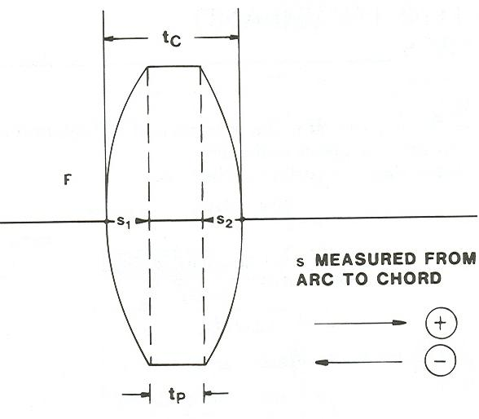
Physical Characteristics of Lenses
Lens Thickness
Influences:
Power
Base Curve
Lens Diameter
Index
Minimum Thickness
Center Thickness for Minus
Edge Thickness for Plus
Note that s₁ is + and s₂ is -

Slide 49
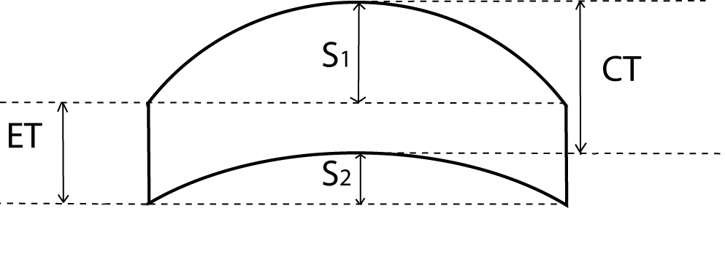
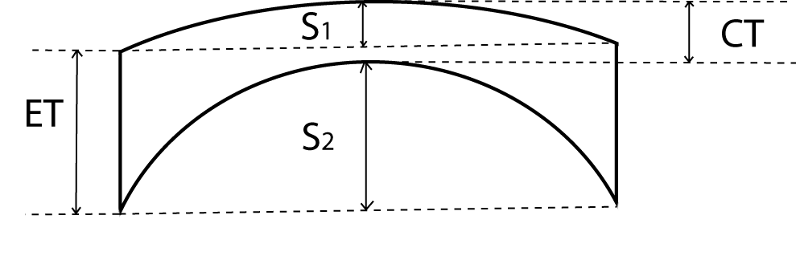
Physical Characteristics of Lenses

Slide 50
Physical Characteristics of Lenses
Power: increase power, increase thickness
Base Curve: flatten base curve, decrease thickness
Diameter:* decrease diameter, decrease thickness
Index: increase index, decrease thickness
Decrease Minimum Thickness:* decrease thickness
Example: use Trivex (allows 1.0mm CT on minus)
* Significant impact

Slide 51
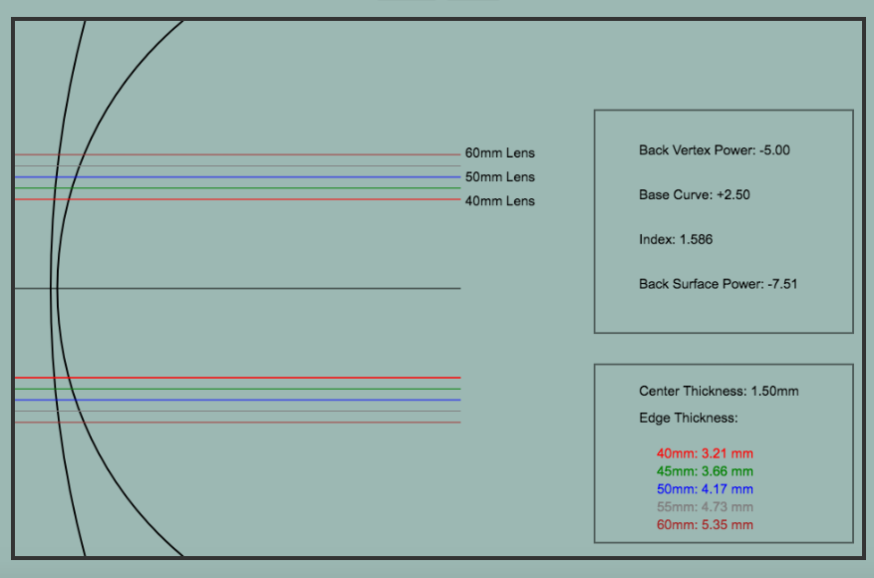
Physical Characteristics of Lenses

Slide 52
Physical Characteristics of Lenses
Example: Rx: -5.00DS Diameter: 60mm
Edge Thickness
CR 39: 6.8mm
High Index (1.70): 5.42mm
Polycarbonate: 5.35mm
CR 39 and 1.70 lenses use 2.2mm CT
Polycarbonate use 1.5mm CT

Slide 53
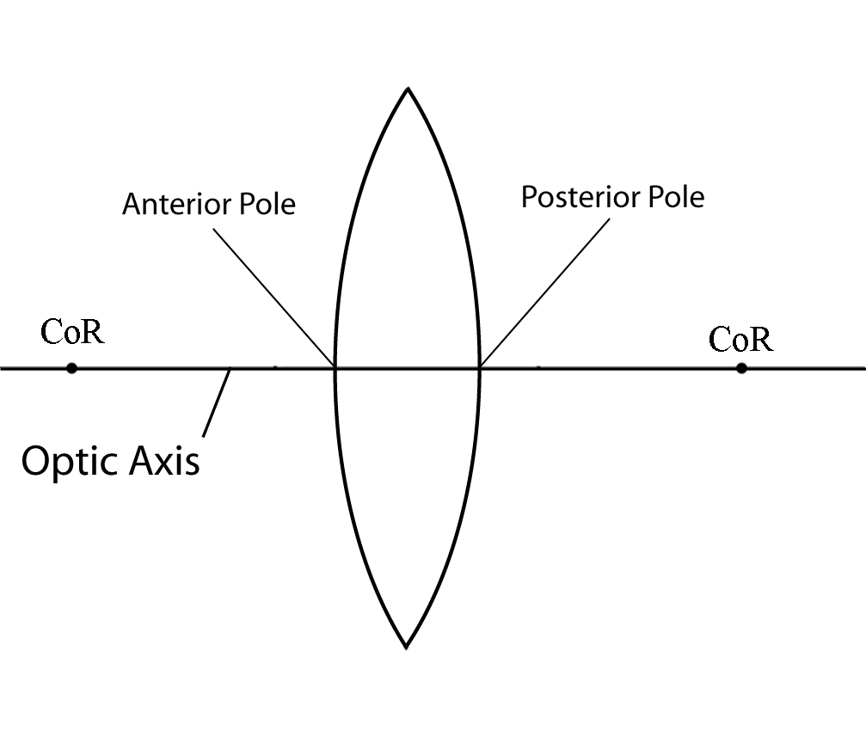
Optical Characteristics of Lenses
Major Reference Points
Optic Axis & Lens Poles

Slide 54
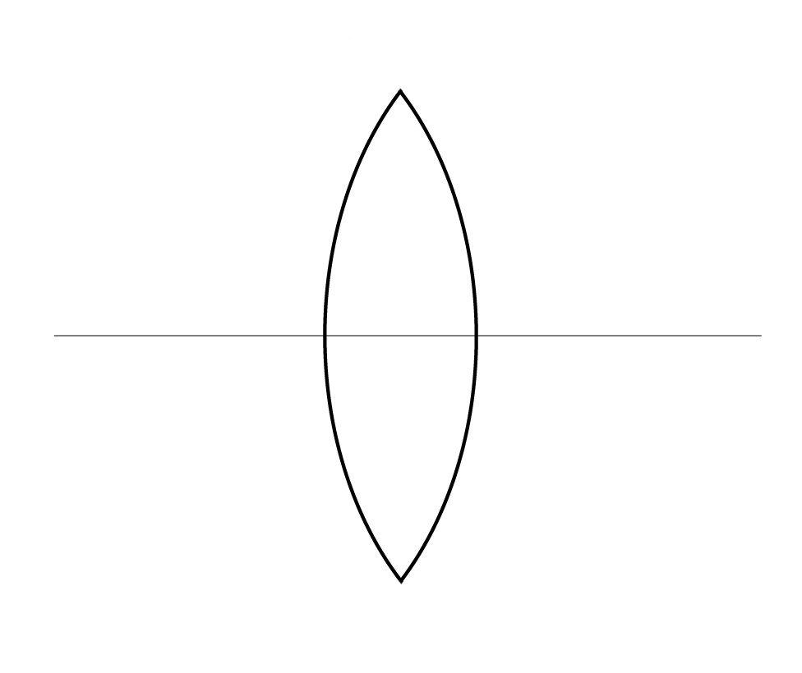
Optical Characteristics of Lenses
Major Reference Points
Optic Center & Nodal Points
N’
N
O

Slide 55
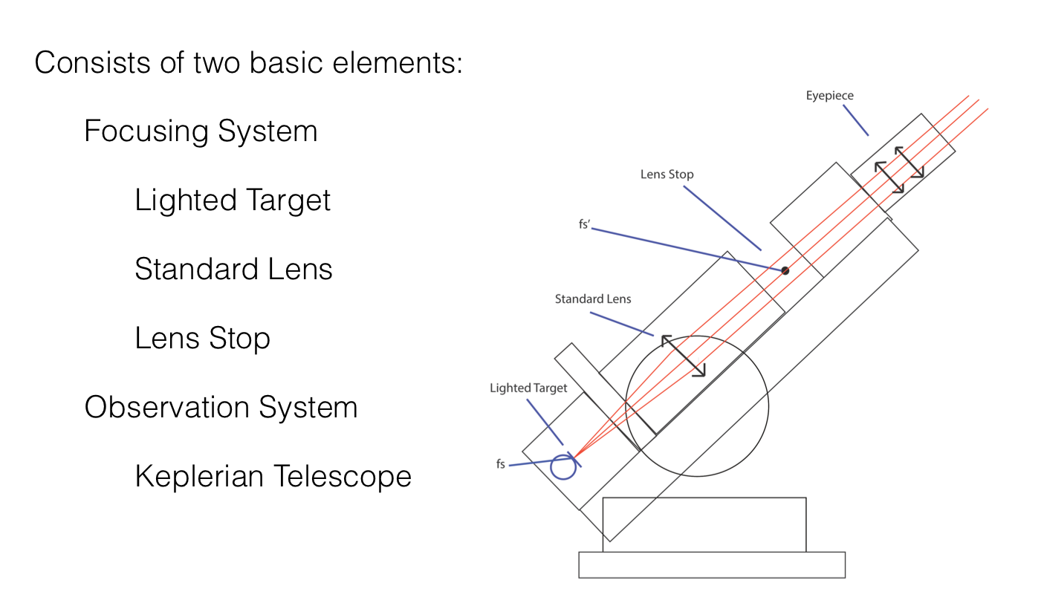
Optical Characteristics of Lenses
Verification of Lens Prescriptions: Lensometer

Slide 56
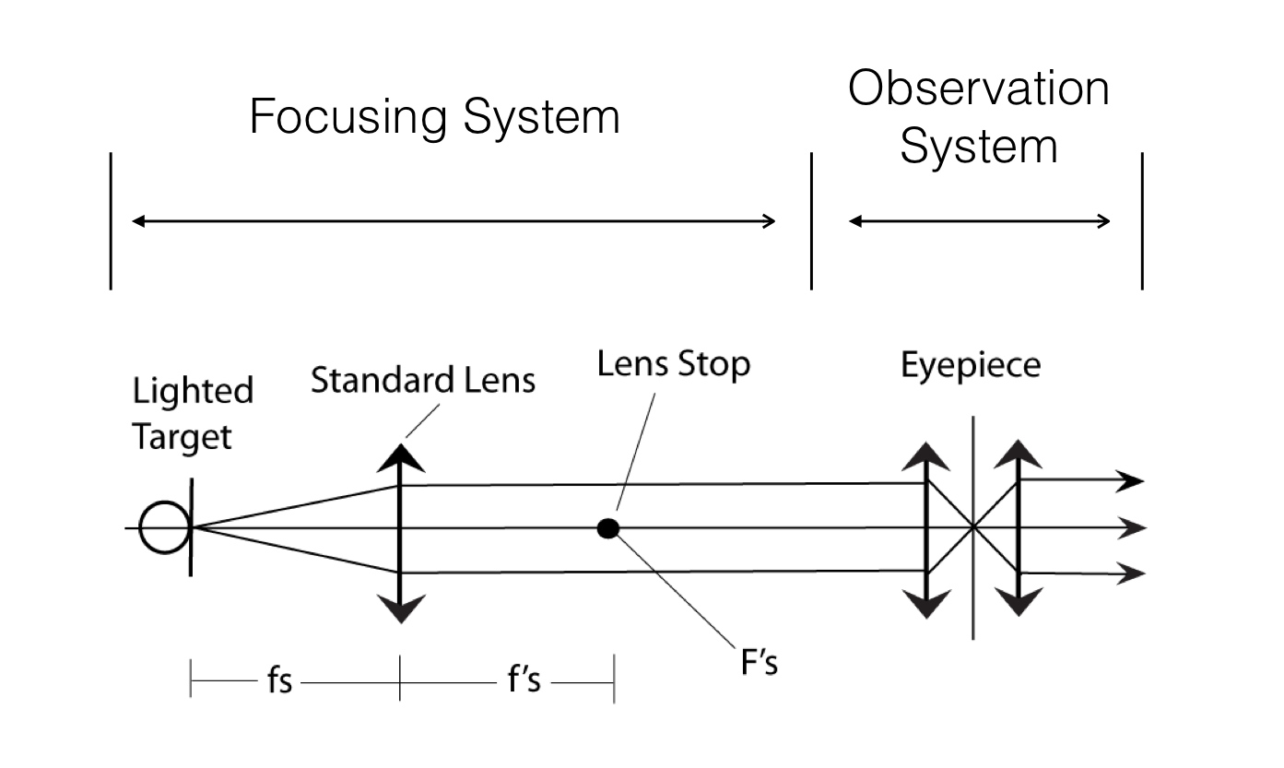
Optical Characteristics of Lenses
Verification of Lens Prescriptions: Lensometer

Slide 57
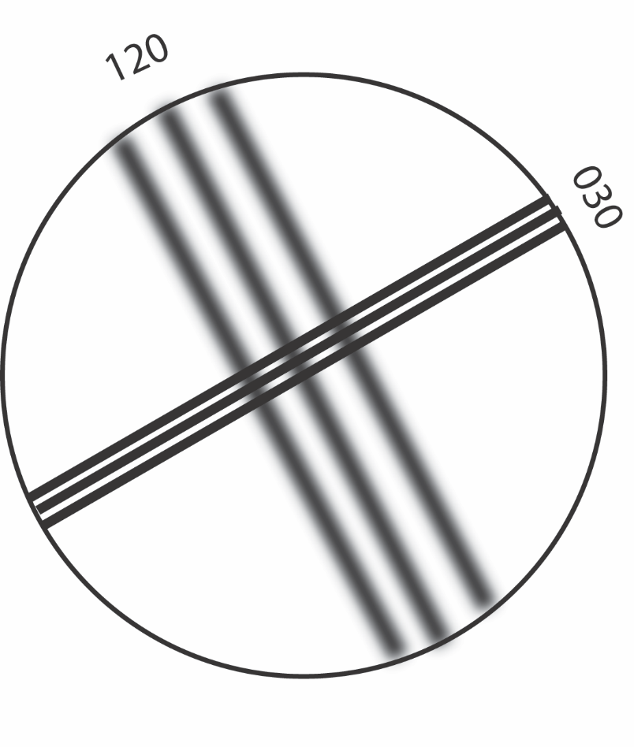
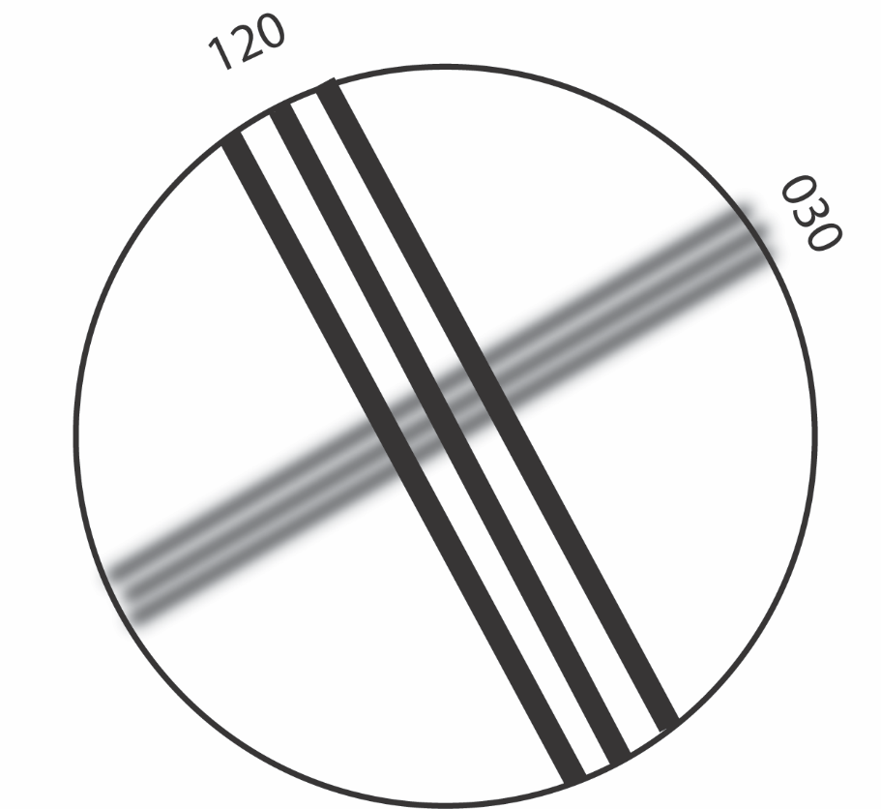
Optical Characteristics of Lenses
Verification of Lens Prescriptions: Lensometer
Image is in focus 090 degrees from meridian being measured:
Sphere is in focus (left image) at +1.00D (power in 120 = +1.00)
Cylinder in focus (right image) at -1.00D (power in 030 = -1.00)
Rx: +1.00 -2.00 x 120

Slide 58
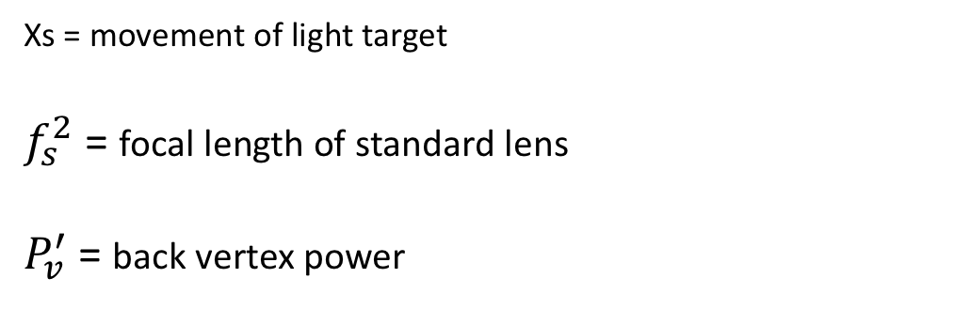
Optical Characteristics of Lenses
Verification of Lens Prescriptions: Lensometer
Amount of target movement determined by power of lens:
Xs = movement of light target
$f_{s}^{2}$ = focal length of standard lens
$P_{v}^{′}$ = back vertex power
Example: x_{s} = +2.5mm for +20D standard lens and a +1.00D “unknown” lens

Slide 59
Optical Characteristics of Lenses
Verification of Lens Prescriptions: Lens Gauge
Determine surface power by measuring sagittal depth
Can determine:
Approximate Power: P1 + P2
Cylinder Power: difference between meridians on back surface
Add Power: difference in front surface powers of lens and segment
Slab Off Prism: difference in reading for distance portion vs reading at slab off line (typically top of segment)

Slide 60
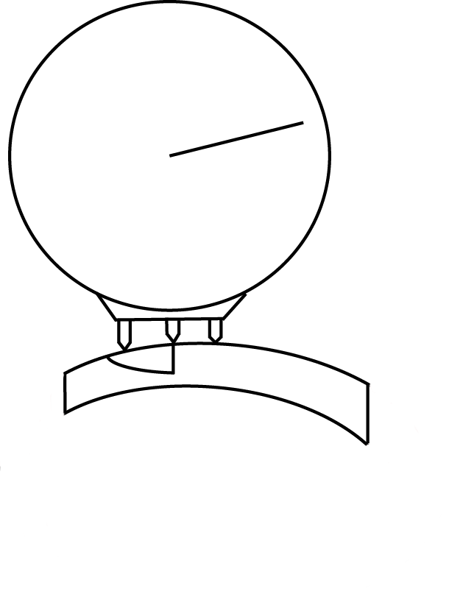
Optical Characteristics of Lenses
Verification of Lens Prescriptions: Lens Gauge
Measuring Slab Off Prism
Compare lens clock reading in vertical meridian for distance portion of lens to lens clock reading at slab off line
Difference in diopters is amount of prism in prism diopters

Slide 61
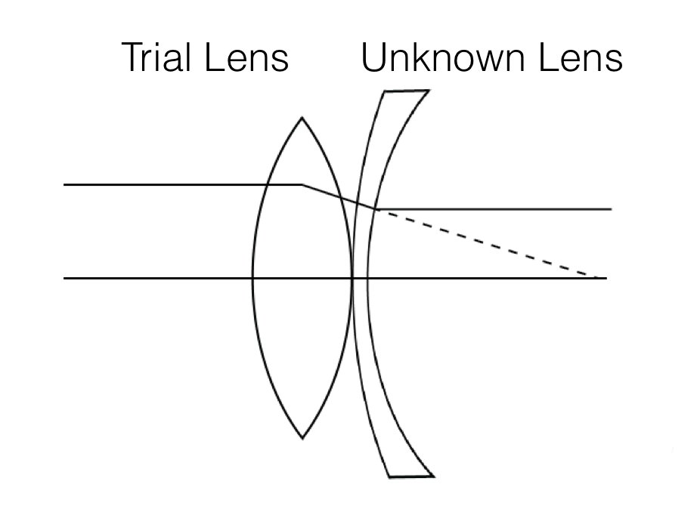
Optical Characteristics of Lenses
Verification of Lens Prescriptions: Hand Neutralization
Measuring Neutralizing (Front Vertex) Power
Neutralize motion seen through lens
Lens power is same magnitude but opposite sign of neutralizing lens
With Motion: net minus for lens combination
Against Motion: net plus for lens combination

Slide 62
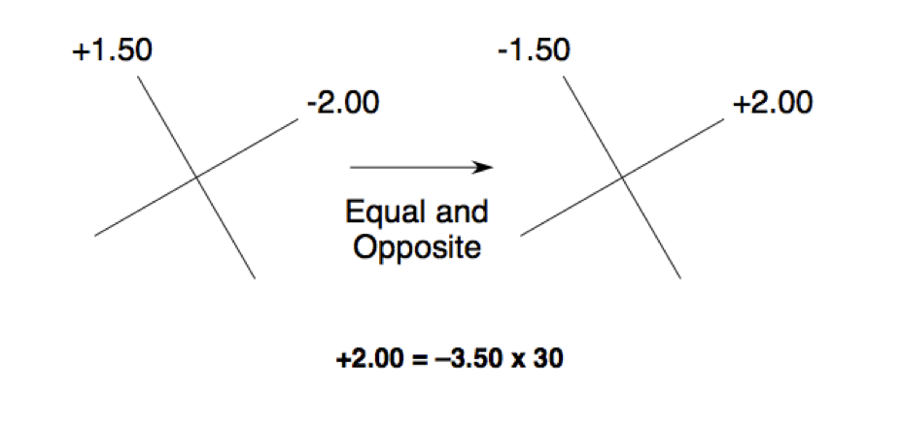
Optical Characteristics of Lenses
Verification of Lens Prescriptions: Hand Neutralization
Measuring Neutralizing (Front Vertex) Power
Example
What is front vertex power:
Neutralizing lenses: -2.00 @ 030 / +1.50 @120

Slide 63
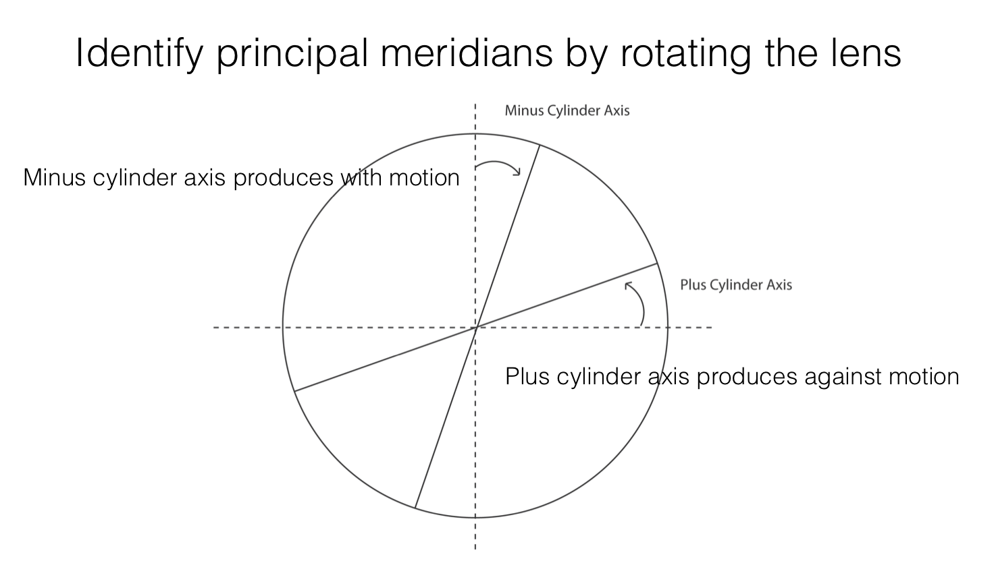
Optical Characteristics of Lenses
Verification of Lens Prescriptions: Hand Neutralization

Slide 64
Optical Characteristics of Lenses
Writing & Transposing Lens Prescriptions
+2.25D
-1.75D
In minus cylinder:
Sphere: most plus power (+2.25)
Cylinder: difference between powers (-4.00)
Axis: most plus meridian (090)
Rx: +2.25 -4.00 x 090

Slide 65
Optical Characteristics of Lenses
Writing & Transposing Lens Prescriptions
Cylinder Transposition in Three Steps
1. Add the sphere and the cylinder powers to obtain the new sphere power
2. Change the sign of the cylinder
3. Rotate the cylinder 090 degrees
Example: Plus cylinder form: -2.50 +0.50 X 090
What is minus cylinder form?
1. –2.50 + (+0.50) = -2.00
2. +0.50 becomes –0.50
3. 090 + 090 = 180
Result: -2.00 –0.50 X 180

Slide 66
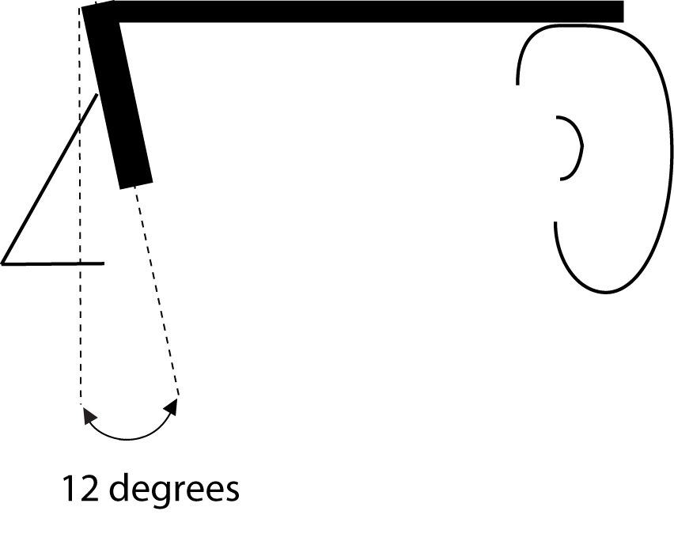
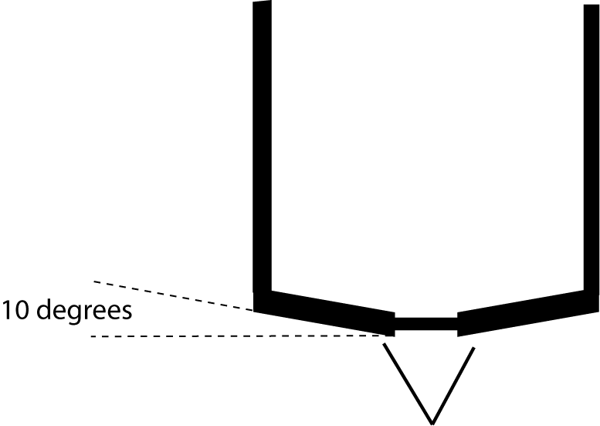
Optical Characteristics of Lenses
Effect of Lens Tilt
Positive Face Form
Pantoscopic Tilt

Slide 67
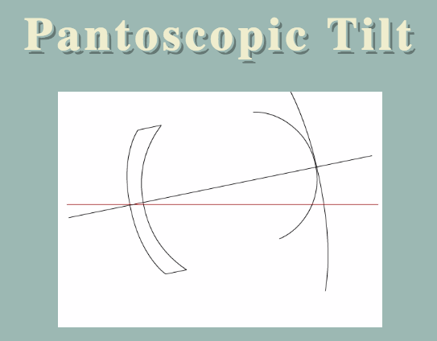
Optical Characteristics of Lenses
Effect of Lens Tilt
Introduces Oblique Astigmatism
Sphere Power Increase (very small)
Introduction of Astigmatism
Plus Sphere creates Plus Cylinder
Minus Sphere creates Minus Cylinder
Axis is same as axis of rotation
Pantoscopic (Retroscopic) Tilt: axis 180
Face Form (positive and negative): axis 090

Slide 68
Optical Characteristics of Lenses
Effect of Lens Tilt
New Sphere Power
Cylinder Power

Slide 69
Optical Characteristics of Lenses
Effective Power
Two Considerations:
Need to change lens power as vertex distance changes
Accommodative demand changes for near objects as vertex distance changes

Slide 70
Optical Characteristics of Lenses
Effective Power
Due to effectivity:
Minus lens becomes more minus when vertex distance decreases
Plus lens becomes less plus (more minus) when vertex distance decreases
To compensate:
Minus Powered CL: decrease Rx compared with spectacle Rx
Plus Powered CL: increase Rx compared with spectacle Rx
Happens for ALL powers, clinically significant at +/- 4.00D

Slide 71

Optical Characteristics of Lenses
Effective Power
d (vertex distance) is positive for movement toward the eye and negative for movement away from the eye
To find Spec Rx (given CL Rx:
$$P_{SPEC}=\frac{P_{CL}}{1+dP_{CL}}$$

Slide 72
Optical Characteristics of Lenses
Effective Power
Due to effectivity:
Compared to emmetropia:
Myopes have lower demand for accommodation with spectacles
Hyperopes have a higher demand for accommodation with spectacles
All Contact Lens wearers have the SAME accommodative demand as emmetropes
Therefore:
Myopes accommodate more with CLs
Hyperopes accommodate less with CLs

Slide 73
Optical Characteristics of Lenses
Spectacle Lens Processing
Lens Manufacturing
Most lenses are initially fabricated as lens blanks by a lens manufacturer
Two Types of Lens Blanks
Finished Blank
front and back surfaces are finished (ground and polished)
have final power for Rx
have to be edged to fit frame
ex: single vision sph and common sph + cyl combinations
Semi Finished Blank
front surface is finished (base curve)
back surface needs to be ground and polished
then edged to fit frame
ex: bifocals, high Rx lenses, sph + cyl (because of orientation)

Slide 74
Optical Characteristics of Lenses
Spectacle Lens Processing
Surfacing: grind correct curve and polish surface
Edging: cut lenses to correct shape and size and finish edge

Slide 75
Frame Measurements & Specifications
Physical Characteristics
Measurements/Specification
Considerations for High Prescriptions

Slide 76
Physical Characteristics & Biological Compatibility of Frame Materials
Metals
  Monel (alloy)
    May contain nickel (allergy potential)
    Plate with palladium or
    other nickel free material
  Titanium
    Lightweight
    Durable
    Corrosion resistant
    Hypoallergenic
Plastics
  Also called zylonite (zyl)
  Cellulose Acetate
  Cellulose Acetate Proprionate
  Blended Nylons
    Polyamides
    Co-polyamides
    Gliamides

Slide 77
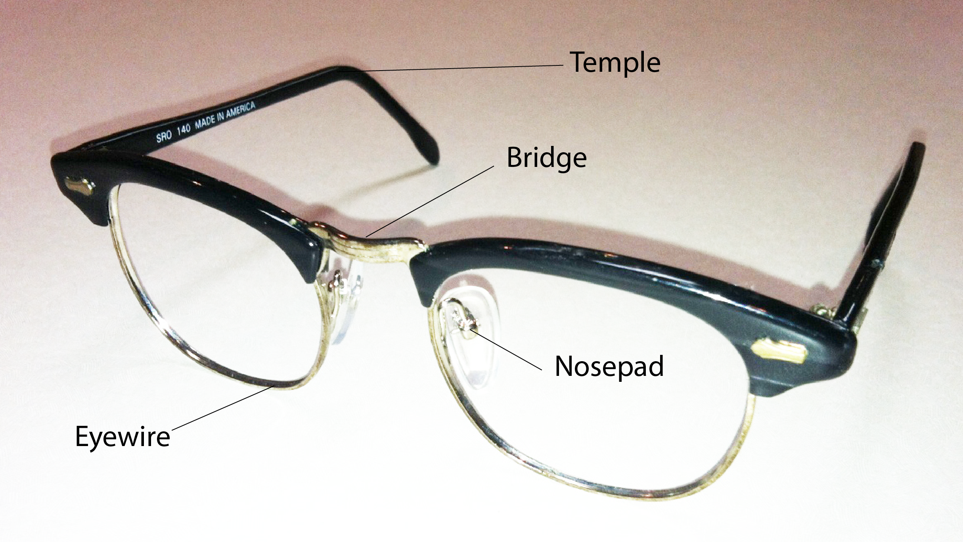
Fitting, Adjustment, Specification, and Nomenclature of Frames
End Piece
Hinge
Front

Slide 78
Fitting, Adjustment, Specification, and Nomenclature of Frames

Slide 79
Optical & Frame Considerations: High Rx Lenses
Optical Considerations
Consider the factors that determine lens thickness
Lens Diameter
Index of Refraction
Minimum Thickness
Base Curve
Lens Prescription
Problems with High Rx Lenses:
Prism in lens periphery
Minus
Edge Thickness / Multiple Ring Effect
Plus
Center Thickness
Magnification
Ring Scotoma

Slide 80
Optical & Frame Considerations: High Rx Lenses
Frame Considerations
Choose a frame that has a Frame PD = Patient PD
This eliminates the need for decentration (assuming no prism in Rx)
Smaller Eye Sizes
Lens diameter has more effect on lens thickness than any other factor
For High Minus
Consider plastic frames
Hide the edges
Reduce / eliminate the multiple ring effect
Don’t choose frames wider than patient’s face
For High Plus
Frame with adjustable nose pads
Reduce vertex distance (reduces magnification)

Slide 81
Multifocal Spectacle Correction
Types
Segment Center Locations
Image Jump
Total Displacement
Placement of Optical Centers
Segment Height & Placement

Slide 82
Multifocal Lenses
Types
Fused
All glass multifocal segments are fused except the glass executive bifocal/trifocal
Achieve add power through a change in index of refraction
Index of segment is higher than index of lens

Slide 83
Multifocal Lenses
Types
One Piece
All plastic multifocal segments are one piece
Glass executive multifocal segments are one piece
Achieve add power with a change in curvature of front surface between main lens and segment

Slide 84
Multifocal Lenses
Types
Progressive Addition Lenses
PALs are a special case of one piece multifocal design
Use continuous change in curvature from distance portion of the lens to the full add portion
PALs are “aspheric” in that they are not spherical surfaces

Slide 85
Multifocal Lenses
Types
Progressive Addition Lenses
Usually have characteristics of either:
Hard Design
Larger Near Portion
Harsh Contours (more unwanted astigmatism)
Shorter Corridor
Soft Design
Small Near Portion
Softer Contours (less unwanted astigmatism)
Longer Corridor

Slide 86
Multifocal Lenses
Types
Progressive Addition Lenses
Usually have characteristics of either:
Hard Design
Better for patient who is “eye mover”
Due to wider reading portion
Soft Design
Better for patient who is “head mover”
Due to less unwanted astigmatism

Slide 87
Multifocal Lenses
Types
Progressive Addition Lenses
There are many specialty PAL designs
Designed for computer/intermediate use
Designed for smaller B (vertical) frame dimensions

Slide 88
Multifocal Lenses
Types
Blended Bifocals
Rarely used
Unlike PAL, there is no functional advantages, only cosmetic
Include areas of unwanted astigmatism

Slide 89
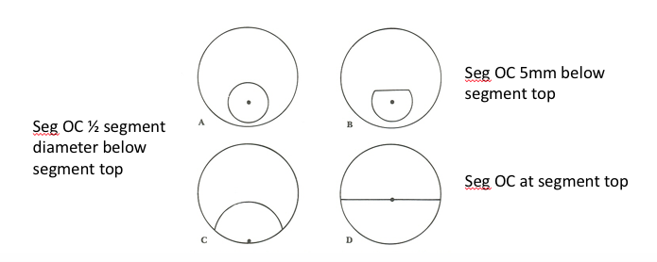
Multifocal Lenses
Segment Center Locations

Slide 90
Multifocal Lenses
Differential Displacement (Image Jump)
Image jump is the prismatic effect at the top of the segment
Amount of image jump is found using Prentice’s Rule
Image Jump = (dist to seg OC) x (add power)
Example: image jump from FT35 +2.00 Add
Image jump = (0.5)x(2.00) = 1.0 prism diopter, base down
Image jump is always base down if present
No Image Jump:
Executive Bifocal & PAL

Slide 91
Multifocal Lenses
Total Displacement (vertical)
Prismatic effect in downgaze at the reading level (RL)
Combine prism from distance Rx and prism from near Rx
Prentice’s Rule (twice)
Once for distance:
Prism from distance = (dist from OC to RL)x(Dist Rx vert meridian)
Once for near:
Prism from near = (dist from seg OC to RL)x(Add Power)

Slide 92
Multifocal Lenses
Total Displacement (horizontal)
Prismatic effect in downgaze at the reading level (RL)
Combine prism from distance Rx and prism from near Rx
Prentice’s Rule (once if segment inset correct)
Once for distance:
Prism from distance = (dist from OC to LOS)x(Dist Rx horiz meridian)
If segment inset is not correct (add):
Once for near:
Prism from near = (dist from seg OC to LOS)x(Add Power)

Slide 93
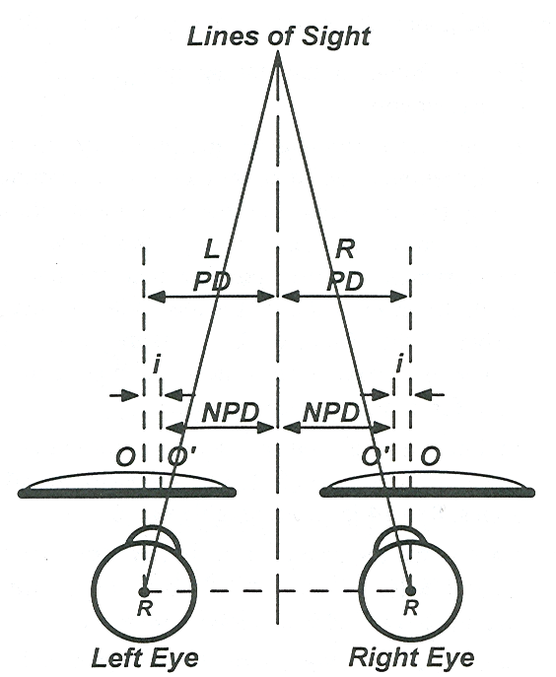
Multifocal Lenses
Placement of Optical Centers
Lateral Placement
Distance: Distance PD
Near: Inset: (Dist PD – Near PD)/2

Slide 94
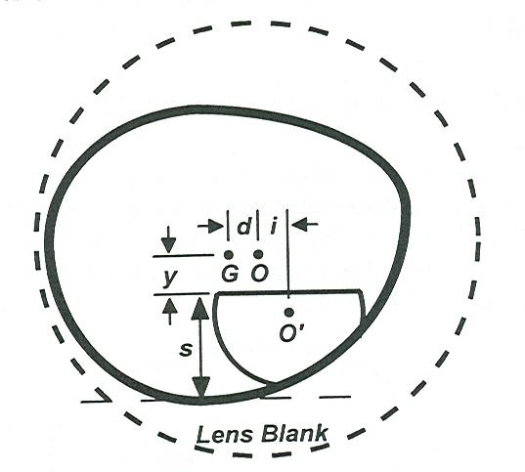
Multifocal Lenses
Placement of Optical Centers
Vertical Placement
Distance: ½ B dimension
Near: determined by seg type and height

Slide 95
Multifocal Lenses
Specifying Segment Height & Placement
inset
Segment Height
Segment Height
Bifocals are typically fitted at lower limbus/lower lid margin
Trifocals are typically fitted higher than bifocal (lower pupil margin)

Slide 96
Tints & Absorptive Coatings
Specification of Lens Tints & Coatings
Characteristics of Photochromic Lenses
Relationship Between Lens Thickness & Spectral Transmission
Special Occupational Requirements

Slide 97
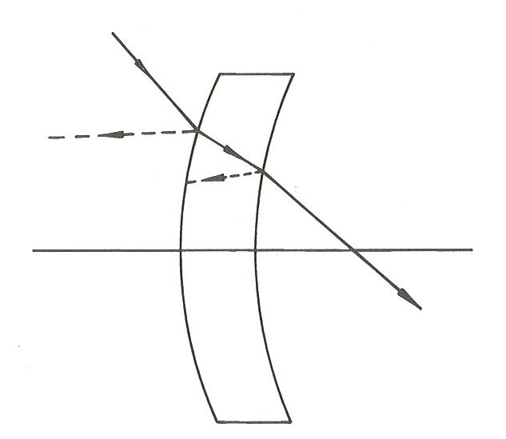
Absorptive Lenses
Specification of Lens Tints & Coatings

Slide 98
Absorptive Lenses
Specification of Lens Tints & Coatings
Transmission of a simple lens:
  Transmission = Incident – Reflected – Absorbed
Transmission of a Lens System
  The product of individual lens transmissions
  T = T₁T₂T₃…
Transmission should be specified as percent Transmission

Slide 99
Absorptive Lenses
Specification of Lens Tints & Coatings
Selective Absorption
Apparent color of lens is a result of the transmission of visible light through the lens
A green lens transmits more green light than any other color

Slide 100
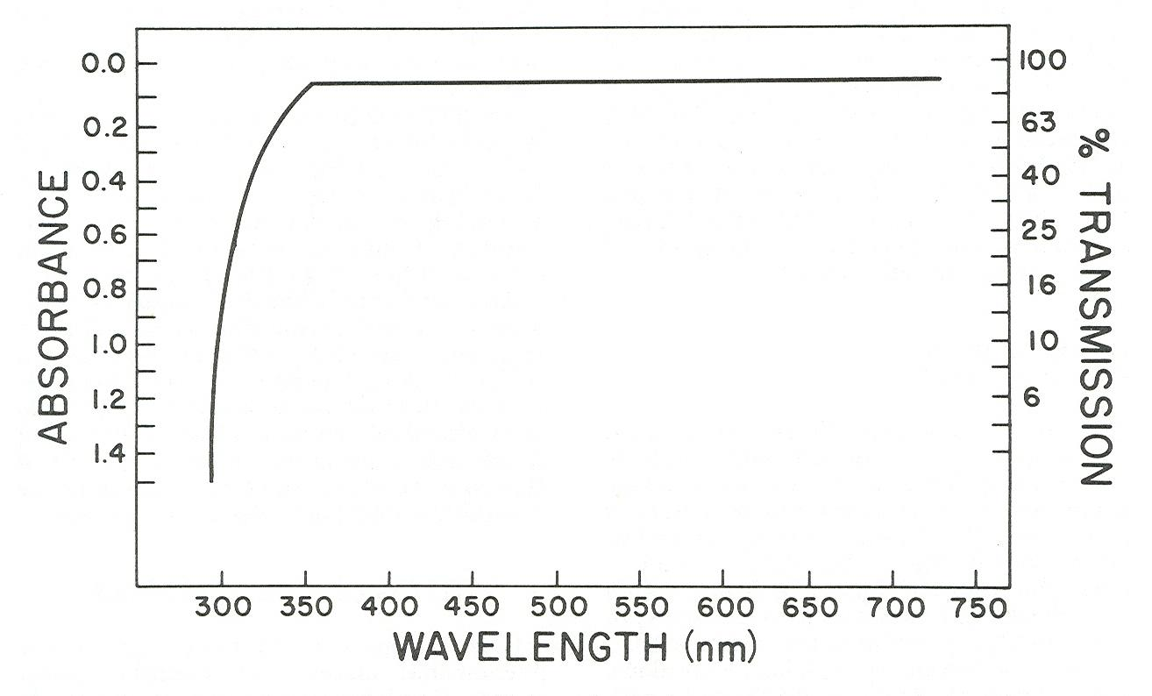
Absorptive Lenses
Specification of Lens Tints & Coatings

Slide 101
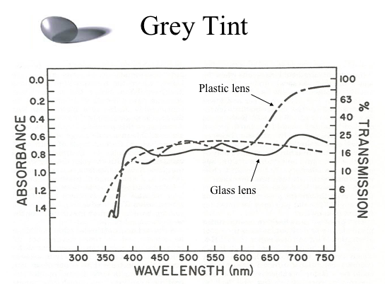
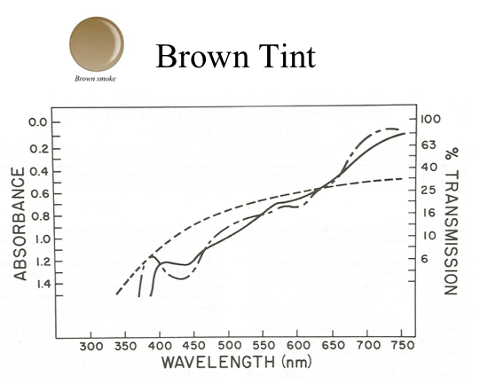
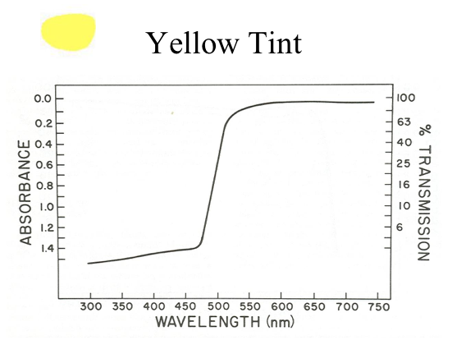
Absorptive Lenses
Specification of Lens Tints & Coatings

Slide 102
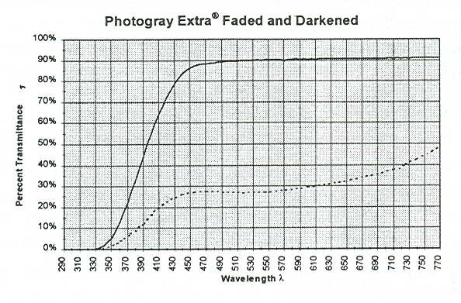
Absorptive Lenses
Characteristics of Photochromic Lenses

Slide 103
Absorptive Lenses
Characteristics of Photochromic Lenses
Transmission is affected by:
Intensity of Incident Light
Wavelength of Incident Light
Temperature
Length of Exposure

Slide 104
Absorptive Lenses
Relationship Between Lens Thickness & Spectral Transmission
Optical Density
Optical Density is a way of expressing the transmission of light through a lens or filter.
Once the density is known for a given thickness, the density of any thickness can be determined by use of proportion.
Optical Density = -log₁₀T
The density for a lens consists of:
2 surface densities (based on reflection)
Media density

Slide 105
Absorptive Lenses
Relationship Between Lens Thickness & Spectral Transmission
Optical Density
For a lens with absorptive tint incorporated into the lens material (this is the case for most glass lenses), the transmission will vary across the lens depending on its thickness.
Minus lenses appear darker in the periphery
Plus lenses appear darker in the center
For plastic lenses, tint is usually applied after manufacturing and lenses absorb the tint evenly across the lens without regard for thickness and so tints appear uniform across the lens.

Slide 106
Absorptive Lenses
Special Occupational Requirements
Typical Occupational Application of Absorptive Lenses
Welding
Use very dark (low transmission) gray lenses
Concern about high UV exposure
And high levels of visible radiation
IR Exposure
Glass Work
Work with molten glass
Blast Furnace
Industries with molten metal
Use Therminon tint (blue-green)

